Slide 1

Isotonix® 的優勢
獨一無二的傳輸系統
The Science behind Isotonix®
YK Tam
高級顧問經理級
Director
四個佣金週期共賺取HK$138,000
HK$138,000 in 4 Commission weeks
本簡報中提到的收入等級純屬舉例說明，無意代表美安香港超連鎖™店主的一般收入，也無意表示任何超連鎖™店主皆可賺取同等收入。美安香港超連鎖™店主的成功與否，取決於其在發展事業時的努力、才能與投入程度。The income levels mentioned in the following presentation are for illustration purposes only. They are not intended to represent the income of a typical Market Hong Kong UnFranchise ™Owner, nor are they intended to represent that any given Independent UnFranchise ™ Owner will earn income in that amount. The success of any Market Hong Kong Independent UnFranchise ™ Owner will depend upon the amount of hard work, talent, and dedication which he or she devotes to building his or her Market Hong Kong Business.

Slide 2
領導市場：
Isotonix®等壓傳輸系統與碧容健®
The Cutting Edge
Isotonix® Delivery System and Pycnogenol®
*碧容健®為賀發研究機構(Horphag Research Ltd.)的註冊商標，使用此產品受一項以上美國專利和其他國際專利的保護。
*Pycnogenol® is a registered trademark of Horphag Research Ltd. Use of this product may be protected by one or more U.S. patents and other international patents.
此演講的內容並未受美國食品及藥物管理局評核。此產品並非作為診斷、醫療或預防任何疾病或狀況之用途。
The statements contained in this presentation have not been evaluated by the Food and Drug Administration. This product is not intended to diagnose, treat, cure or prevent any disease.

Slide 3
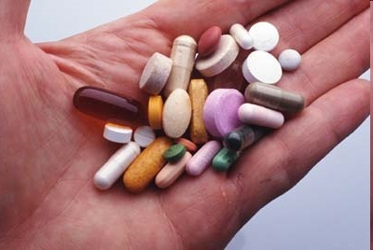
科學為本 vs.「偽科學」
Science-Based vs. “Junk Science”
每天都有很多人購買營養補充品
常見的選擇有
  鈣補充劑
  綜合維他命
  奧米加脂肪酸或魚油
  抗氧化劑
A large percentage of peoples are purchasing supplements every day
Common choices are
  Calcium supplements
  Multivitamins
  Omega or Fish Oils
  Antioxidants
Notes:
Agree to agree- as many as 70% of everyone who walks through HP’s door are purchasing supplements each
and every day, whether it's Calcium, or a One-a-day Multiple vitamin or Omega III or handfuls of who-knows-what!

Slide 4
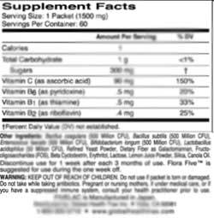
科學為本 vs.「偽科學」
Science-Based vs. “Junk Science”
最受歡迎的品牌中，大多有吸引人的標籤，上面寫滿各種營養素，但這些產品同時也含有
  人造化學色素
  人造調味劑
  防腐劑
  崩解劑
  「填充劑」，例如滑石、澱粉、氫化油、化學糖衣等
其他成份
Others Ingredients
Many of the most popular brands have attractive labels full of nutritional ingredients, but also contain :
- Artificial chemical pigments - Artificial flavors
- Preservatives - Disintegrants
- "bulk fillers" such as talc or starch, hydrogenated oil, chemical coatings
Notes:
“Even though there are more credible scientific studies coming out year in and year out that support nutritional supplementation and it's benefits, I think we can also agree that the industry as a whole is riddled with a lot of "Junk science."

Slide 5
科學為本 vs.「偽科學」
Science-Based vs. “Junk Science”
市面上大部份維他命片劑及膠囊的吸收率都很低（不會溶解）
就算維他命丸可被溶解，亦需曝露於胃液與酵素中45分鐘至4小時，才可到達腸道被吸收
Most commercial vitamin tablets and capsules have poor absorption rates (“bedpan bullets”)
Even the vitamin pills can be dissolved, its need exposure to gastric juices and enzymes in 45 minutes to 4 hours before they reach the intestines for absorption
Notes:
Couple that with the fact that most commercial tablet and capsule vitamins have poor absorption rates. (bedpan bullets)
Even the vitamin pills that do breakdown, are exposed to 45 minutes to 4 hours of bombardment by stomach acids and enzymes before they ever reach the absorption site in the intestines. In the process most of the nutrient content is destroyed.

Slide 6
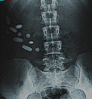
Notes:
For those that may need further convincing, we see here an x-ray of pills taken that did not dissolve. They did not get absorbed into the bloodstream and get to release their actives.

Slide 7
藥丸在傳輸上的缺點
Disadvantages of Pill Delivery
藥丸在進入腸道之前可能尚未完全溶解
藥丸可能會卡在胃壁的皺摺中
藥丸可以溶解，但是吞服藥丸時所喝下的水會讓胃將胃中的內容物傾倒至腸道，使吸收部位變得飽和
Pills may not completely dissolved before moving into the intestinal tract
Pills can get caught in the folds of the stomach
Pills can be dissolved, but the taken water may make the stomach dump contents and saturated the absorption sites
D.Y. Graham et al What Happens to Tablets and Capsules in the Stomach…J. Pharm. Sci. 1990, Vol. 79, No. 5 pp 420 - 424

Slide 8
選擇營養補充品時，
你和顧客應該考慮哪些因素？
What should you and your customers consider when choosing nutritional supplementation?
高效傳輸系統（高生物利用率）
全面、成份具協同作用的配方
味道和口感良好
以科學為本
高標準的品質管制
適當標籤資料，包括列出注意事項與禁忌
Efficient delivery system (good bioavailability)
Comprehensive and synergistic formulations
Taste and palatability
Scientifically based
High standards for quality control
Good label information including warnings and contraindications

Slide 9
傳輸與生物利用率
Delivery & Bioavailability
傳輸系統相當重要：
  等壓吸收 > 膠囊 > 藥丸/藥片
  添加劑與增量劑導致吸收率下降
  膠囊與藥丸常常需要依賴胃酸
生物利用率是甚麼？
  反映身體可以吸收並且利用營養素的量
  受傳輸系統與配方
  （如氨基酸螯合配方）影響
Delivery system is very important:
Isotonic > capsules > pills/tablets
Binders and fillers can decrease absorption
Capsules and pills often rely on stomach acid
What is bioavailability?
  Reflects the amount of nutrient your body can absorb and utilize
  Dependent on the delivery system and the formulation
  (e.g. amino acid chelate)

Slide 10
Isotonix®配方促進快速、受控的營養傳輸
Isotonix® is Formulated for Fast, Controlled Delivery of Nutrients
Isotonix®產品以適當的糖份比例精心調配。因此，Isotonix®產品不會因吸收位置飽和而限制維他命的吸收。
Isotonix® products have been carefully formulated using the right ratio of sugars in the right amounts. Because of this, Isotonix® products do not limit vitamin absorption by saturating the absorption sites.
Notes:
Isotonix products are carefully formulated using the right ratio of sugars in the right amounts. Because Isotonix empty from the stomach in a controlled fashion, the absorption sites and carriers are not saturated. This promotes maximum absorption.

Slide 11
何謂等滲壓(isotonic)?
What does isotonic mean?
如果用來形容一種要吸收的溶液，「等滲壓」就表示與人類體液的液壓相同，即是，食物經過胃部消化變成溶液，準備進入小腸被吸收的狀態。
Isotonix產品配方中的果糖、葡萄糖、檸檬酸、碳酸氫鉀及其他主要成份搭配均衡，以確保正確調配飲用時達到等滲狀態。
When used to describe solutions that are meant for consumption, isotonic means having the same fluid pressure as body fluids.
Isotonix products are formulated with the proper balance of fructose, d-glucose, citric acid, potassium bicarbonate and other key ingredients to assure that they are isotonic when properly prepared.

Slide 12
Isotonix®－最卓越的營養補充品之一
Isotonix®－ One of the Best Supplements
產品為粉狀，無需如片劑般加入添加劑、粘稠 劑、 膜衣和潤滑劑
不含膠囊或其他添加劑
吸收營養補充品所需的時間和工作便大大減少
Powders, none of the fillers, binders, coatings and lubricants that are common to tablet manufacturing are necessary
No gelatin capsules or fillers
Amount of time and work necessary to absorb a supplement is greatly decreased

Slide 13
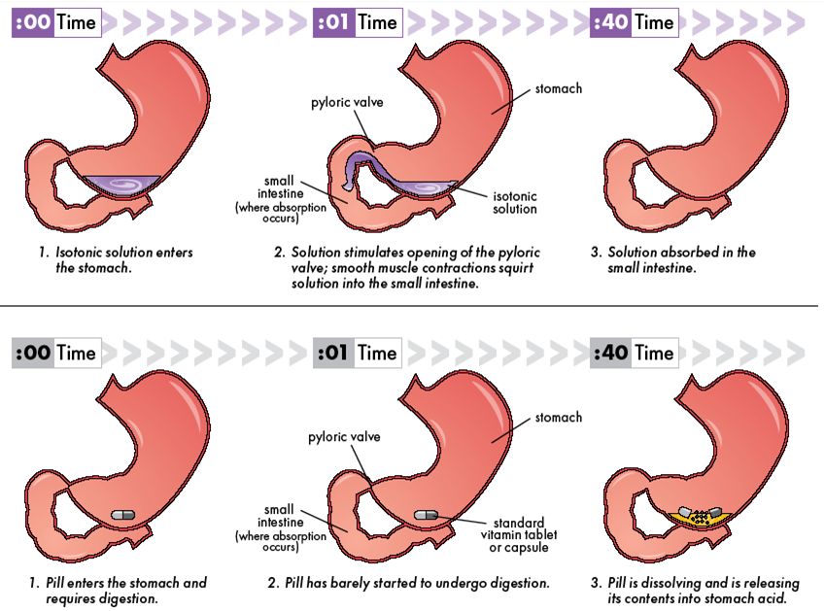
Isotonix®傳輸系統
Isotonix
迅速被人體吸收
Rapidly absorbed by the body
高濃度的維他命和礦物質
High concentration of
vitamins and minerals
效果顯著
Maximum results
吸收率較低
Minimal absorption
營養素被稀釋
Dilated nutrients
一般片劑/膠囊/軟膠囊
tablet/ capsule/ softgel

Slide 14
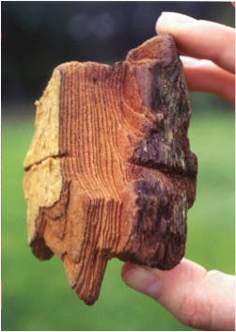
碧容健® About Pycnogenol®
四大基本功用：強效的抗氧化物、天然的抗炎劑、能選擇性地與膠原蛋白和彈力蛋白結合及有助產生一氧化氮，幫助血管舒張
~400篇科學文章與臨床實驗證實其安全、不含毒性及具臨床功效
4 basic properties: a powerful antioxidant, a natural anti-inflammatory, selectively binds to collagen and elastin and aids in the production of endothelial nitric oxide, which helps to dilate blood vessels
~400 scientific articles and clinical trials have confirmed Pycnogenol’s safety, absence of toxicity and clinical efficacy
碧容健®為賀發研究機構(Horphag Research Ltd.)的註冊商標，使用此產品受一項以上美國專利和其他國際專利的保護。
*Pycnogenol® is a registered trademark of Horphag Research Ltd. Use of this product may be protected by one or more U.S. patents and other international patents.

Slide 15
Isotonix OPC-3® 的吸收率
Isotonix OPC-3® Absorption
Cesarone et al., Phytother Res, in print 2008
3
抗氧化物
作用率增加
單位／分鐘
Increase of
antioxidant
impact rate
units/minute
2
OPC-3
等滲透壓 Isotonic
1
OPC-3
片劑 tablet
0
10
min
20
min
30
min
40
min
50
min
60
min
70
min
80
min
90
min
2
h
2½
h
3
h
3½
h
4
h
分鐘
分鐘
分鐘
分鐘
分鐘
分鐘
分鐘
分鐘
分鐘
小時
小時
小時
小時
小時

Slide 16
結果The Results
「總括來說，研究顯示就抗氧化功能而言，等壓狀態OPC-3®內的類黃酮於人體的生物利用率遠高於相同份量的片劑混合物。」
“In conclusion the findings demonstrate that the flavonoid mixture provided in isotonic OPC-3® is significantly more bioavailable in humans, in terms of antioxidant activity than an equivalent mixture in tablet form.”
等壓狀態的OPC-3®生物類黃酮的抗氧化生物利用率較高
Accelerated antioxidant bioavailability of OPC-3® bioflavonoids administered as isotonic solution
Cesarone et al. Phytotherapy Research 23, 775-777(2009)

Slide 17
結果The Results
服用Isotonix OPC-3®後，血漿氧化壓力大幅降低10.1%
所有主要心血管健康風險因素均有改善，血壓、膽固醇及空腹血糖水平均降低
Plasma oxidative stress status was significantly lowered by 10.1% with Isotonix OPC-3 ®
All major cardiovascular risk factors were improved with blood pressure, total cholesterol, and fasting blood glucose lowered

Slide 18
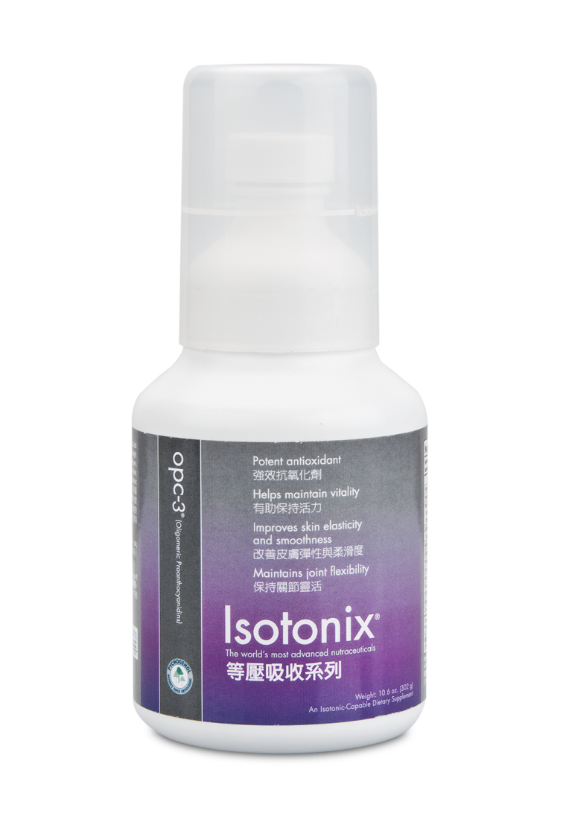
Isotonix OPC-3®
^{285 – 290}
^{milliosmoles/kg}
^{（滲透壓單位）}
^{無可比擬的卓越產品！}
^{THERE IS NO COMPETITION!}

Slide 19
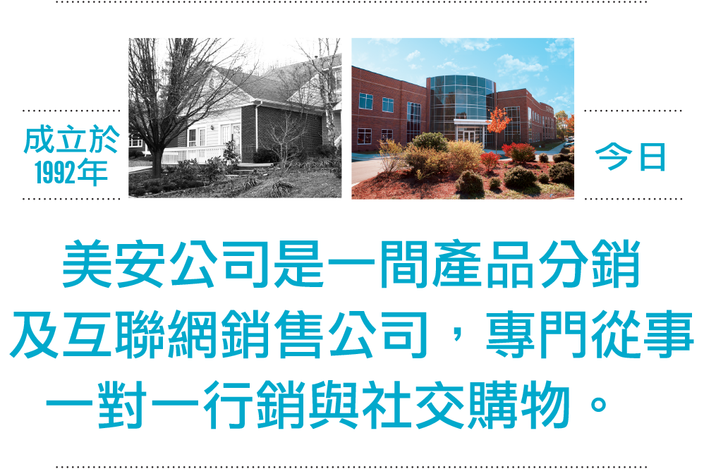
成立於1992年
FOUNDED
IN 1992
今曰
TODAY
美安香港是一間產品分銷及互聯網銷售公司，
專門從事一對一行銷與社交購物。
Market Hong Kong is a Product Brokerage and Internet Marketing Company that specializes in One-to-One Marketing and Social Shopping.

Slide 20


